Slide 1
SPEAKING PRACTICE
LET’S TALK USING OUR ENGLISH SKILLS

Slide 2
OBJECTIVE
To have a fluent and dinamic speaking practice in small groups in the classroom.

Slide 3
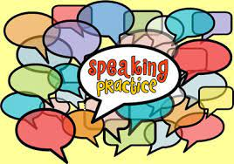
QUESTIONS
TELL ME ABOUT YOUR FAMILY.
2. TELL ME ABOUT YOUR EDUCATIONAL BACKGROUND.
3. WHAT ACTIVITIES DO YOU LIKE?
4. WHAT IS THE WEATHER LIKE TODAY?
5. WHAT WILL THE WEATHER BE TOMOROOW?
6. WHAT IS YOUR FAVORITE DAY? WHY?
7. WHAT’S GOING ON?

Slide 4
PRACTICE IN SMALL GROUPS. COLLABORATIVE LEARNING.
.

